Slide 1
Perpetual Day of Remembrance
Stations of the Cross
We Lament and We Hope

Slide 2
The First Station: Jesus in the Garden of Gethsemane

Slide 3
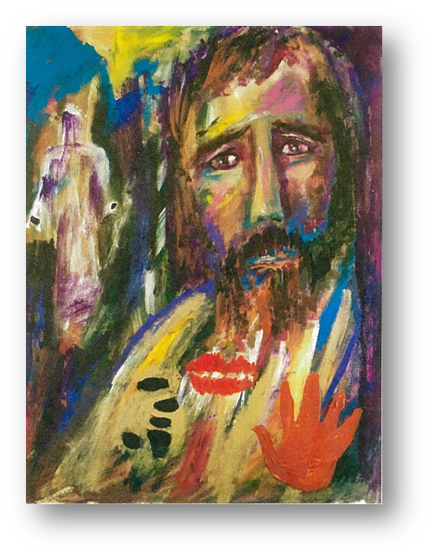
The Second Station: Jesus, betrayed by Judas, is arrested.

Slide 4
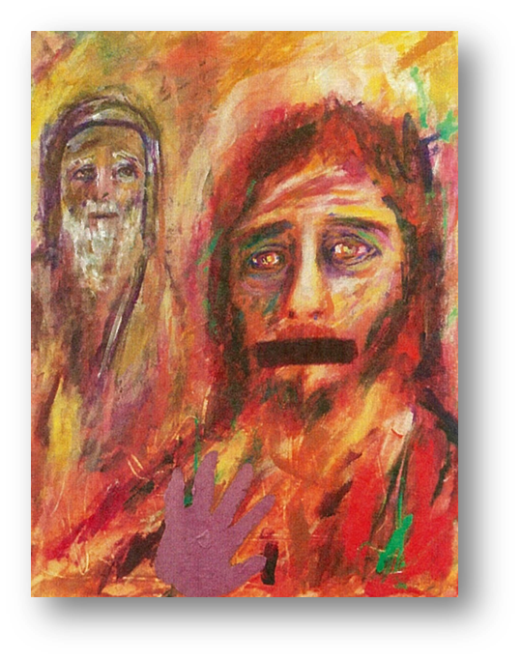
The Third Station: Jesus is condemned by the Sanhedrin

Slide 5
The Fourth Station: Jesus is denied by Peter

Slide 6
The Fifth Station: Jesus is judged by Pilate

Slide 7
The Sixth Station: Jesus is scourged and crowned with thorns

Slide 8
The Seventh Station: Jesus bears the cross

Slide 9
The Eighth Station: Jesus is helped by Simon the Cyrenian to carry the cross

Slide 10
The Ninth Station: Jesus meets the women of Jerusalem

Slide 11
The Tenth Station: Jesus is crucified

Slide 12
The Eleventh Station: Jesus promises his Kingdom to the good thief

Slide 13
The Twelfth Station: Jesus speaks to his mother and the disciple

Slide 14
The Thirteenth Station: Jesus dies on the cross

Slide 15
The Fourteenth Station: Jesus is placed in the tomb

Slide 16
Acknowledgments
These diocesan Stations of the Cross are based on The Stations of the Cross in Atonement for Abuse and for the Healing of All. Paul Turner author. Ronald Patrick Raab CSC illustrator. Published by Liturgical Press, Collegeville, Minnesota. © 2020. All rights reserved. Permission was sought and given by Liturgical Press to amend the text and use the images for the purposes of marking the Perpetual Day of Remembrance in the Diocese of Maitland-Newcastle. (June 22, 2022).
Cover image: Fr Andrew Doohan. All rights reserved. Cross: Image by Elisabeth Leunert from Pixabay.

